Slide 1
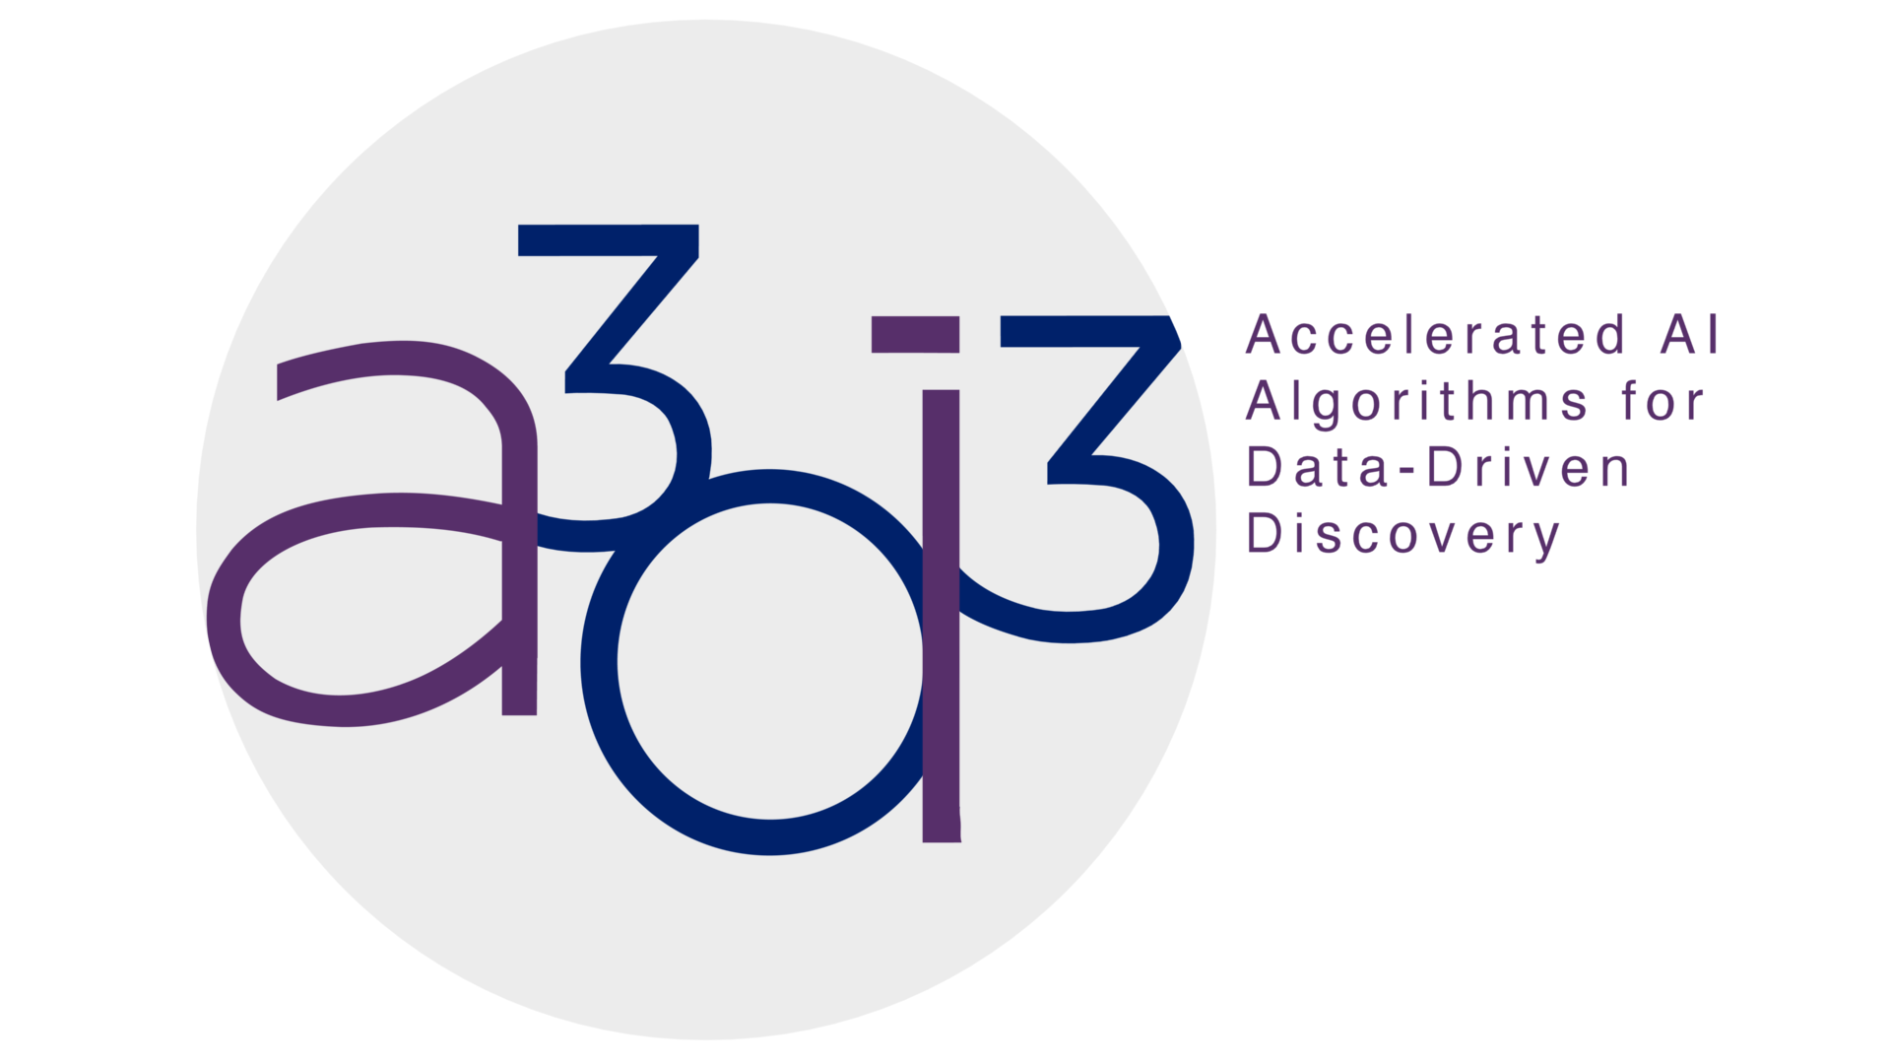

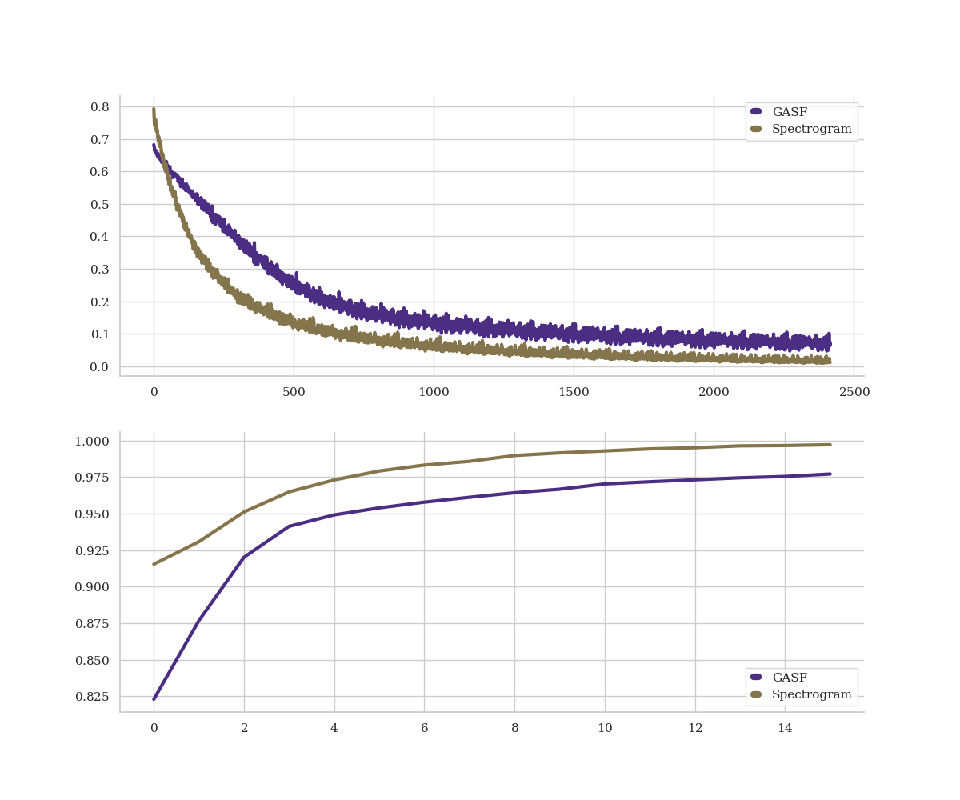
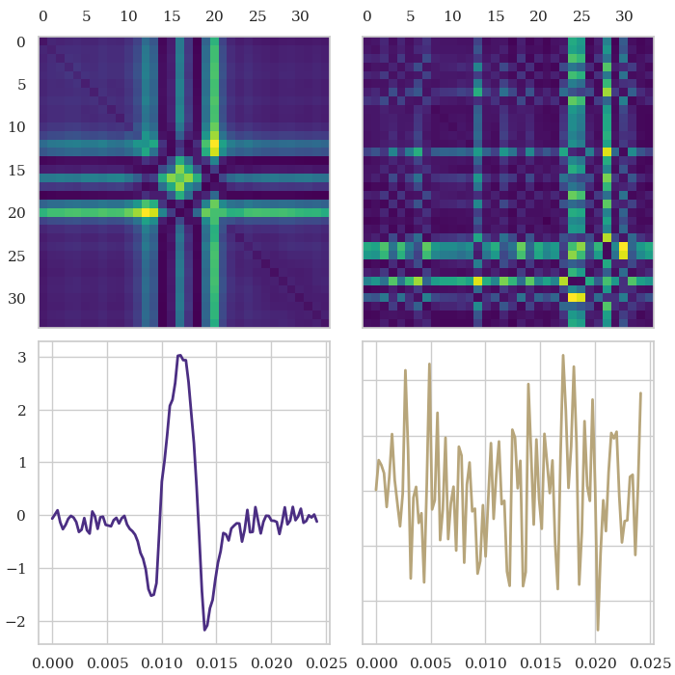
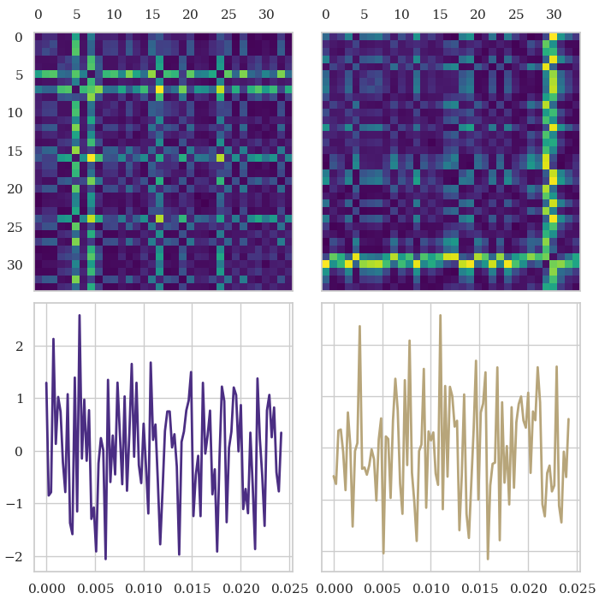
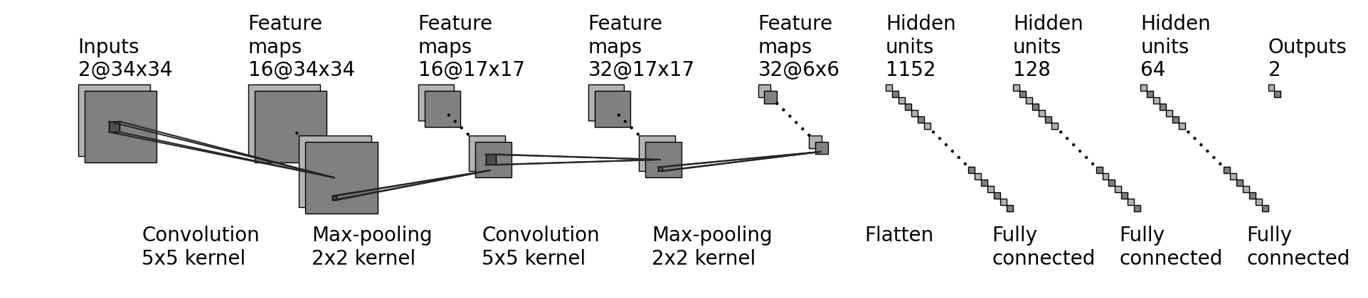
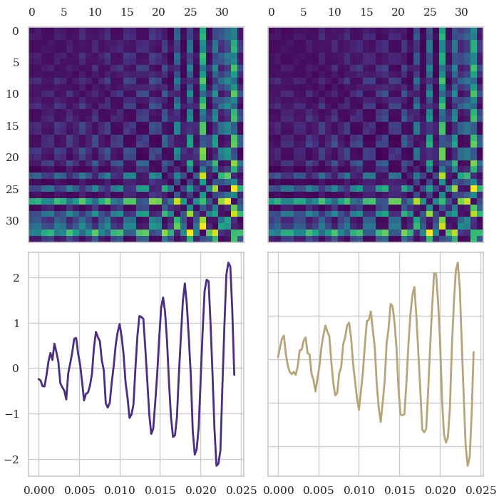
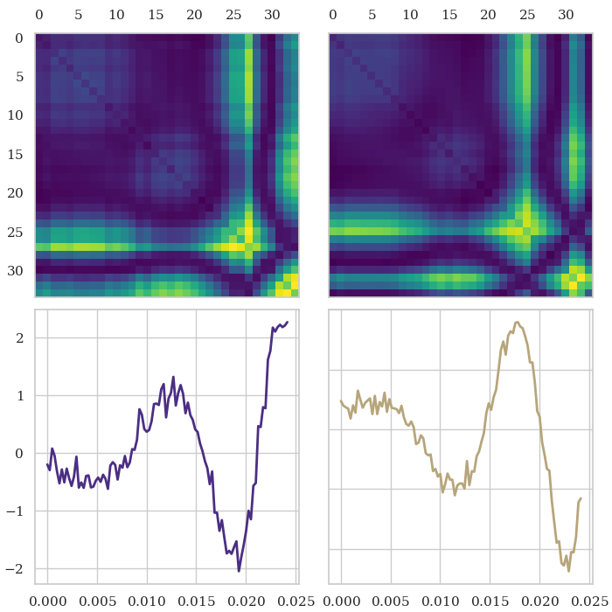
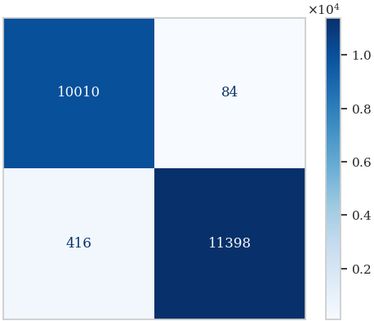
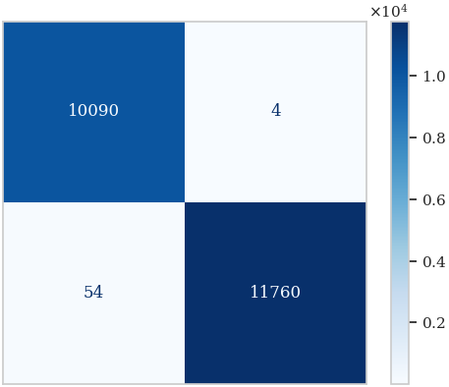
UNRAVELING GRAVITATIONAL RIPPLES: NEURAL NETWORK CLASSIFICATION
Daniel Fredin¹, Cole Welch¹
¹Department of Physics, University of Washington
In accordance with OAC-2117997
INTRODUCTION
QUICK FACTS ABOUT OUR CNN
> ~ 97% testing accuracy
> Data split of 70% training, 15% validation, and 15% testing
> Dataset contains a total of 146045 gravitational wave time series data points
> Applied Gramian Angular Summation Field (GASF) algorithms to encode gravitational wave data as 2D images for classification
> Neural network contains 2 convolutional / max-pooling layers followed by 3 fully connected layers and an output
CONCLUSION
Dataset source: Glitch dataset originates from the Laser Interferometer Gravitational-Wave Observatory (LIGO) in Hanford, WA, and Livingston, LA.
LIGO observatory: Designed to identify and understand the sources of gravitational waves using light and space characteristics.
Dataset categories: Consists of four distinct data categories - Glitch, Background, Sine-Gaussian (SG), and Binary Black Hole (BBH).
Objective: Develop a binary classifier to identify signals as either Glitch/Background or Sine-Gaussian/Binary Black Hole using GASF vs Spectrogram.
Objective: Analyzing the potential of CNNs for classifying gravitational waves strain data as background noise/glitches or transient sine-gaussian/binary black hole merger signals.
Approach: Utilized a streamlined variation of a CNN based upon versions existing in literature.
Performance: Exceeded the anticipated 85% accuracy by attaining an impressive testing accuracy of 97%.
Comparison: Achieved accuracy slightly below more complex CNNs documented in literature and slightly lower than the spectrogram method.
Further exploration: Examining the efficacy of the GASF technique in transforming time series data into images and feeding them through a basic CNN, by using a dataset of more contaminated gravitational waves for analysis.
METHODOLOGY
Gramian Angular Summation Fields
Definition: Method for visualizing time series data in a two-dimensional image format.
Conversion: Converts time series into a symmetric matrix which represents the pairwise angles between points in the time series.
Application: Provides visual representation of complex temporal patterns which is useful for tasks like classification of time series data.
Image Conversion: Convert time series data to 2D images using Gramian Angular Summation Fields (GASFs) with the pyts library.
Image size: GASF images are 28x28 pixels for a balance between performance and accuracy.
Data splitting: Split data into training (70%, 102227 images), testing (15%, 21910 images), and validation (15%, 21908 images) sets.
CNN architecture:
Two convolution layers with batch normalization and max pooling layers applied after each convolution layer three subsequent fully connected layers with dimensions 1568x128, 128x64, and 64x2, respectively.
Training: Trained for 16 epochs, learning rate of 5e-6, batch size of 677, L2 regularization with coefficient 0.001.
Loss function and optimizer: Cross-entropy loss function and Adam optimizer.
 | Training Loss and Validation Accuracy
Training Loss
Validation Accuracy
 | Epochs
Iterations
 | Glitch
 | Detector 1 | Detector 2
 | Pixels | Pixels
Strain
Strain
 | Time (s) | Time (s)
 | Background
 | Detector 1 | Detector 2
 | Pixels | Pixels
Strain
Strain
 | Time (s) | Time (s)
Epochs
 | Sine-Gaussian
 | Detector 1 | Detector 2
 | Pixels | Pixels
Strain
Strain
 | Time (s) | Time (s)
 | Binary Black Hole
 | Detector 1 | Detector 2
 | Pixels | Pixels
Strain
Strain
 | Time (s) | Time (s)
Top: The training loss of the CNN plotted against the number of iterations.
Bottom: The validation accuracy of the CNN plotted against the number of elapsed epochs.
Confusion Matrix |  | Confusion Matrix
 |  | GASF | Detector 2 |  |  | Spectrogram
Truth | Background |  |  | Truth | Background
Strain | Signal |  |  | Strain | Signal
 |  | Background | Signal |  |  | Background | Signal
 |  | Predicted |  |  |  | Predicted
Basic structure of our convolutional neural network (CNN).
DATA ANALYSIS
Scaling: Utilized the StandardScaler function to ensure data was normalized before conversion to GASF images.
Model output: Probability predictions of images for background or signal compared to ground truth targets with Softmax function.
Testing and accuracy: Tested trained model against a separate testing dataset, achieved an overall accuracy of 97%.
Misclassification patterns: Model tends to misclassify when detectors have conflicting data.
Possible flaws: Confusion may arise from contradictory signals between detectors or flaws in observatory data capture.
REFERENCES
An example of the four signal categories derived from the time series data, along with their corresponding GASF images captured by both Detector 1 and Detector 2.
[1] Z. Wang and T. Oates. Encoding Time Series as Images for Visual Inspection and Classification Using Tiled Convolutional Neural Networks. In The Twenty-Ninth AAAI Conference on Artificial Intelligence. (AAAI), January 2015.
[2] T. S. Fernandes, et al. Convolutional Neural Networks for the classification of glitches in gravitational-wave data streams, arXiv:2303.13917v1 [gr-qc], March 2023.
[3] D. George, H. Shen, and E. A. Heurta. Glitch Classification and Clustering for LIGO with Deep Transfer Learning. Phys Rev. D, 97:101501, May 2018.
RESULTS
Model performance: After 16 epochs and over 2400 iterations, training loss reached 0.1, while the validation accuracy approached 96%.
Testing accuracy: CNN model demonstrated an exceptional accuracy of 97% when evaluated on the testing dataset.
Comparison with literature: Similar CNN architectures in the literature achieved higher accuracies, such as 99% (Fernandes et al., 2018) and 98.8% (George D. et al., 2023).
Dataset differences: Our dataset consisted of separate time series for gravitational wave signal data and noise data, while other works had to apply more complex noise filtering methods.
Image conversion: Gramian Angular Summation Fields were effective for image conversion in our case, while others found Fourier transforms more suitable for handling complex noise and background through frequency domain filtering.
Gramian Angular Summation Fields (GASF)
ACKNOWLEDGEMENTS
Definition: Method for visualizing time series data in a two-dimensional image format.
Conversion: Converts time series into a symmetric matrix which represents the pairwise angles between points in the time series.
Application: Provides visual representation of complex temporal patterns which is useful for tasks like classification of time series data.
[1] Z. Wang and T. Oates. Encoding Time Series as Images for Visual Inspection and Classification Using Tiled Convolutional Neural Networks. In The Twenty-Ninth AAAI Conference on Artificial Intelligence. (AAAI), January 2015.
[2] T. S. Fernandes, et al. Convolutional Neural Networks for the classification of glitches in gravitational-wave data streams, arXiv:2303.13917v1 [gr-qc], March 2023.

